Slide 1
Analysis
Project by Raj Jadhav
Notes:
3 seconds
In alignment with the Pyramid Principle, start your presentation by letting the audience know upfront what is your investment decision for the company. The rest of the presentation will build upon this decision.

Slide 2
Dataset Methodology/ Peculiarities
1] The Dataset consists raw of data gathered by various mystery visitors who visited various Coaching Center locations of a company all around India.
2] The data contains very detailed feedback from the visitors ranging from evaluating the aesthetics of the center ( both physical and website) to evaluating the staff, interior and overall metrics.
3] The peculiarities of this dataset are the scores allotted by the visitors which can clearly give an idea of how well the center is performing( There is one total KPI and 9 sub KPIs). 4] The data also contains elaborate feedback of various instances of experience which can be used for sentiment analysis as well as generating word clouds (when we have large amount of data). 5] The size of the data set is small it contains only 56 records (rows) but 123 columns.

Slide 3
Actionable Insights
Statement 01
Identifying top 5 traits of staff for best rated staff interaction (5 ) by evaluators
Statement 02
Enlist the factors that made the customers feel 'Highly Satisfied' and rate the service '5' on the scale of 1 to 5.
Statement 03
Extract negative factors encountered when assessing the Website Enquiry Section. Highlight all the positives and negatives encountered

Slide 4






Top 5 traits of staff with best rating
Welcoming and professional environment
Satisfactory Justification/responses
Active Listening
Great Knowledge of all the courses
Notes:
30 seconds
This slide should provide a brief overview of the company by answering 2 very simple questions:
What problem is the company trying to solve?
What is their solution?
This sets the stage for a deeper dive into the specific reasons that makes/does not make the company a promising investment opportunity.

Slide 5




What all did the customers specifically like? (Overall)
Professional and friendly staff members (sp. Receptionist and Salesperson)
Follow back through calls within 48 hours of visit/enquiry
User friendly and aesthetic website
Excellent center Infrastructure with all the necessities

Slide 6
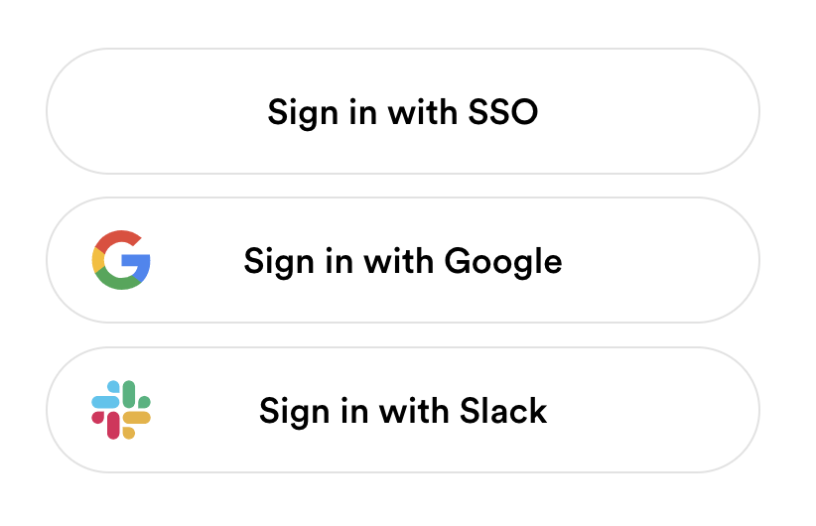

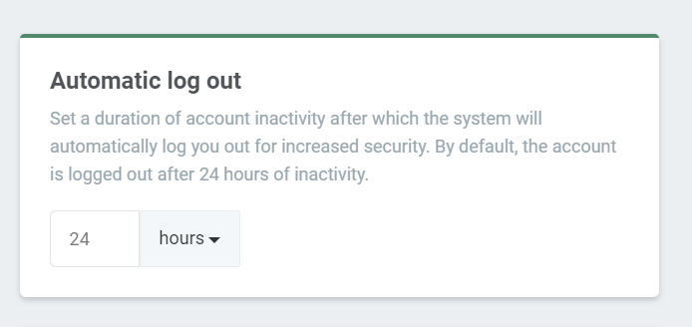
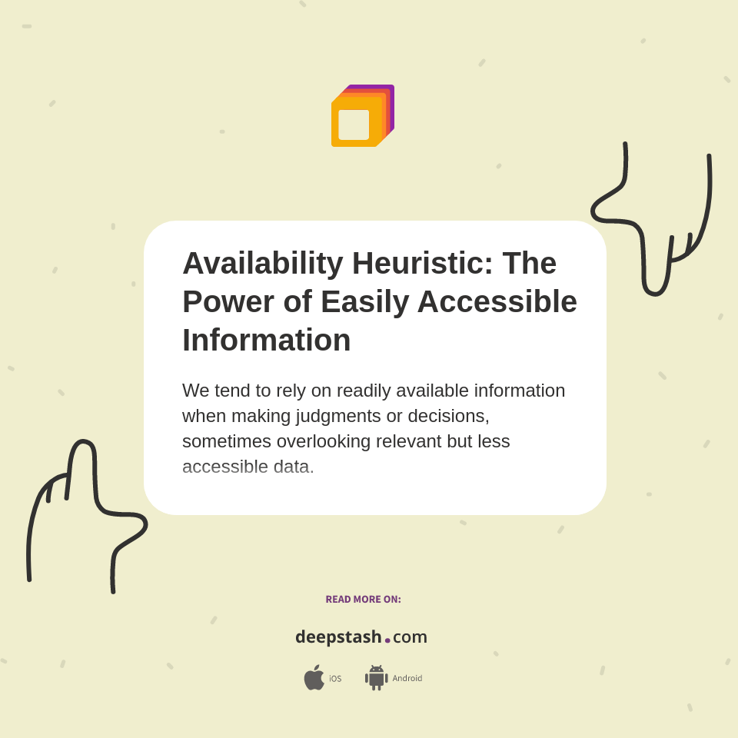


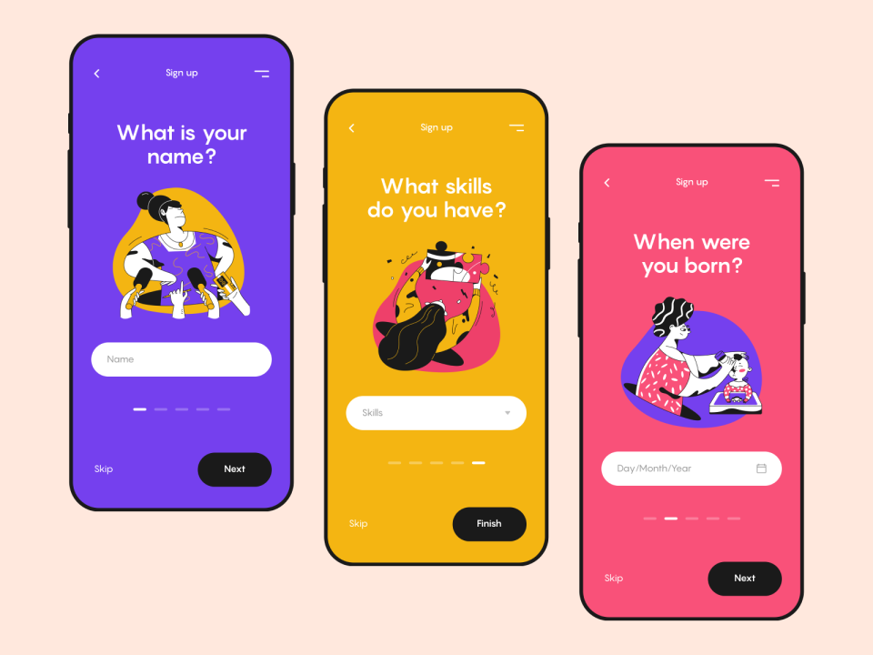


Website Enquiry Reviews Evaluation
Negatives
Positives
Customized option to specify user visit timings and communication methods
All required information such as courses, centers, faculty, success stories, forms etc. readily available
Provide alternate ways to sign in apart from mobile number
Easy to navigate, user friendly and visually appealing website
Information on expected Response times
No follow up phone call after enquiry
Easily accessible ‘Book a Visit’ option
Auto log out feature for security reasons
Mobile interface clutter
.

